Slide 1


Machine Downtime
Praful Bhagwan Gaikwad
https://www.linkedin.com/in/praful-gaikwad-a54663200

Slide 2
Contents
Business Objective
Business Constraints
Project Architecture
Data Collection
Exploratory Data Analysis
Data Visualization
Notes:
Change

Slide 3
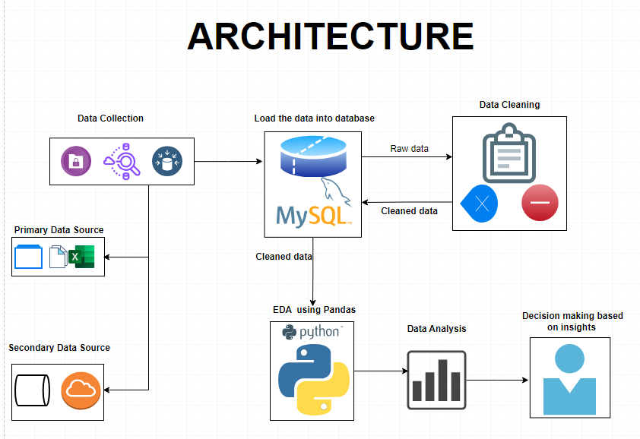
Project Architecture

Slide 4
Business Problem
Manufacturing pumps involves various machines and processes, which are critical for the production process. Unplanned machine downtime in a pump manufacturing facility can have significant negative consequences for productivity, cost-efficiency, and overall operations.
The main business problem is as follow:
Machines which manufacture the pumps. Unplanned machine downtime which is leading to Loss of productivity

Slide 5

Business Objective
Objective
Constraints
Minimize maintenance cost.
It is a crucial goal for any organization, as it can lead to increased operational efficiency and cost savings. To achieve this, you can implement several strategies and best practices
Minimize unplanned machine downtime is the main business objective.
This indicates the low business and production that leads to the loss of organization.

Slide 6
Project Overview and Scope
The project involves working with a leading vehicle fuel pump manufacturer to address a critical business problem. The primary issue at hand is unplanned machine downtime in the manufacturing process, which is adversely affecting productivity. Machine downtime can disrupt the production process, result in loss of output, and increase maintenance costs. The client's business objective is to minimize unplanned machine downtime while also keeping maintenance costs in check.
Scope of the Project:
Client and Business Problem
Data Analysis
Data Preprocessing
Data Exploration Correlation Analysis
Feature Engineering
Recommendations

Slide 7
Data Dictionary
It contains the data as follows ;-
Date : Date
Machine_ID : Alphanumeric
Assembly_Line_No : categorical data
Hydraulic_Pressure(bar) : numerical data
Coolant_Pressure(bar) : numerical data
Air_System_Pressure(bar) : numerical data
Coolant_Temperature : numerical data
Hydraulic_Oil_Temperature(Â°C) : numerical data
Spindle_Bearing_Temperature(Â°C) : numerical data
Spindle_Vibration(Âµm) : numerical data
Tool_Vibration(Âµm) : numerical data
Spindle_Speed(RPM) : numerical data
Voltage(volts) : numerical data
Torque(Nm) : numerical data
Cutting(kN) : numerical data
Downtime : categorical data

Slide 8
Exploratory Data Analysis [EDA]
Statistical Insights
Business Insights
The code calculates the
sum of mean,
sum of standard deviation,
sum of max, sum of min,
sum of max - min,
sum of skewness values, and
sum of kurtosis values
for numeric columns. These values provide summary statistics for the dataset.
The business insight of this project revolves around a leading vehicle fuel pump manufacturer's goal to minimize unplanned machine downtime in their production process while simultaneously minimizing maintenance costs.
The key insights and objectives are as follows:
Minimize Unplanned Machine Downtime:
Cost Saving:
Data-Driven Decision-Making:
Machine Health Monitoring:
Predictive Maintenance
Correlation Analysis:
Visualization
Feature Engineering:
Notes:
EDA is used for seeing what the data can tell us before the modeling task.
Change

Slide 9
Data Preprocessing
Data Reading:
Initially, you loaded the dataset into your environment using the pd.read_csv function. This step is essential for bringing the data into your analysis environment, making it ready for further preprocessing and analysis.
Dataset Information:
Started by gaining an understanding of the dataset's structure and characteristics using the data.info() method. This step provided valuable insights into the data's columns, data types, and any missing values.
Descriptive Statistics:
This utilized the data.describe() method to generate summary statistics for the dataset. This allowed you to gain insights into the central tendency, dispersion, and distribution of numerical features in the data.
Duplicate Data Identification:
To ensure data integrity and consistency, identified duplicate records within the dataset using the data.duplicated() method. This step is crucial in maintaining data quality and can help in detecting and handling redundant information.
Notes:
Keep observations

Slide 10
Data Visualization
The Data visualisation is the graphical representation of data to help people understand the patterns, trends, and insights within the data.
Various data visualizations are created using Seaborn and Matplotlib, such as histograms, box plots, and a heatmap of the correlation matrix. A countplot is used to visualize the distribution of the 'Downtime' variable, indicating the frequency of each category.
We have Visualize key variables, specifically Hydraulic_Pressure (measured in bar), Coolant_Pressure (measured in bar), and Air_System_Pressure (measured in bar), to gain insights and a visual understanding of their distributions and characteristics.
Notes:
Add graphical

Slide 11


